Slide 1
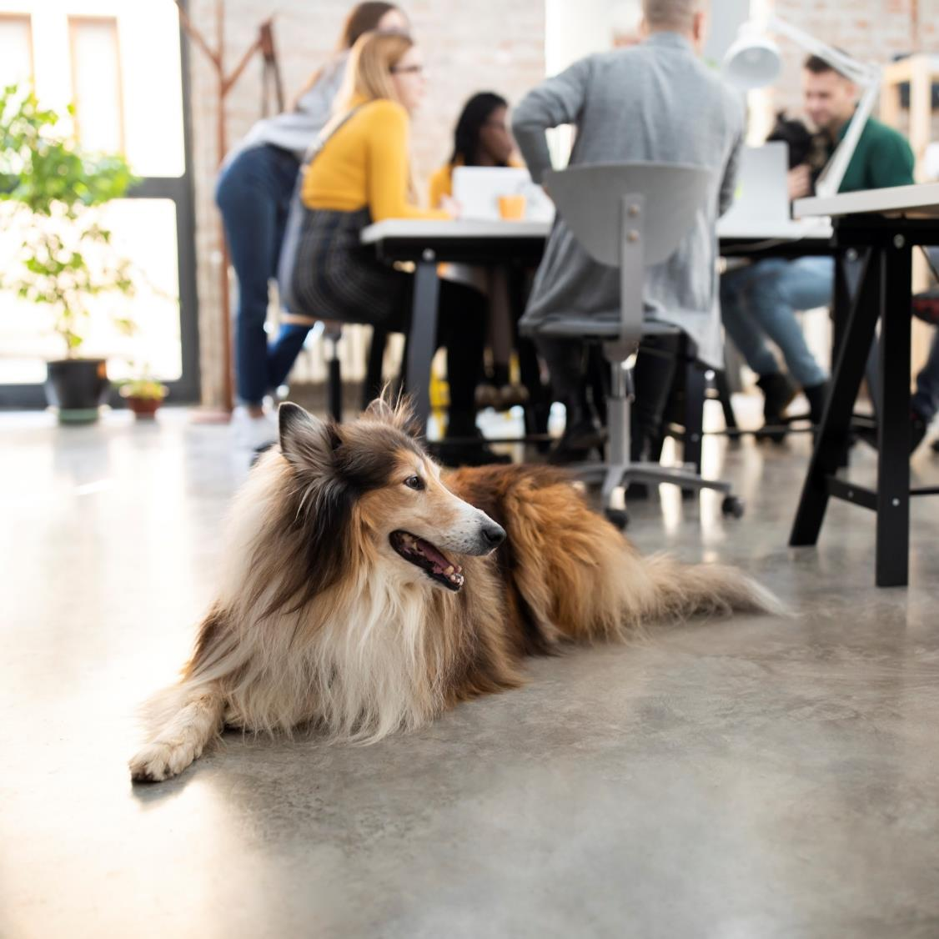
Why [INSERT COMPANY NAME HERE] should make pets welcome.

Slide 2
The bond between people and pets has never been stronger.
89% of dog owners say post-pandemic, it’s important for them to keep spending time with pets during the workday.

Slide 3
This trend is only going to grow.
64% of Gen Z dog owners say they’d change jobs or reduce hours to have more time with their pets.

Slide 4
Boosts happiness
Relieves anxiety or stress
58%
57%
Pets make workplaces better:
Pet parents say having dogs at work…
Encourages healthy breaks
Supports more social interaction
58%
52%

Slide 5
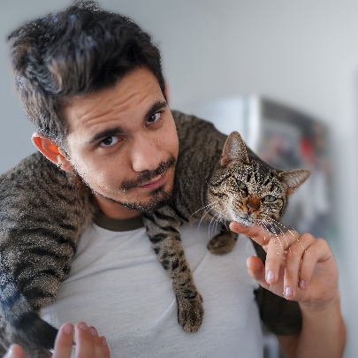
Pet owners tend to visit doctors less often and spend less money on medication.
They make people better, too:
The presence of dogs increases the number and length of people’s conversations with others.
People with pets tend to have healthier responses to stress, including lower heart rate and blood pressure.

Slide 6
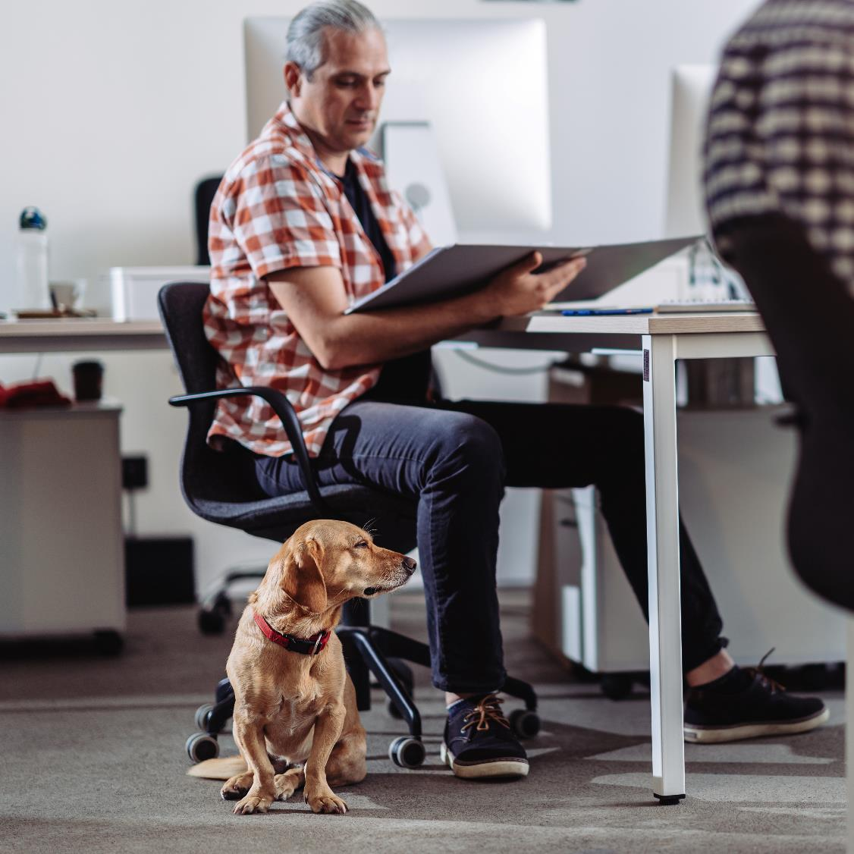
They might even help retention:
Nearly half of dog owners said it would be harder to leave their jobs if their companies allowed them to bring pets to work.

Slide 7
Leading companies are making pets welcome…
[ADD DIRECT COMPETITORS AS NEEDED]

Slide 8
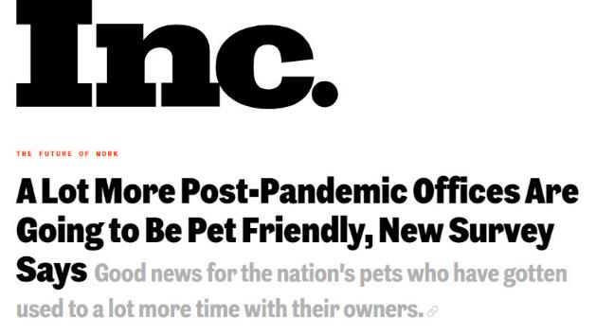
…and they’re making headlines.

Slide 9
So how do we get there?

Slide 10
Steps to get started
Understand ordinances and requirements for pets here at our office
Determine how to offer needed amenities like pet relief area
Survey to get input from employees
Develop pet policy and participant pledge
Create signage and educational materials
Communicate the program
Track feedback to keep refining for success

Slide 11
Key legal considerations
If in a leased space, confirm property owner alignment
Confirm local and industry rules and regulations don’t pose an obstacle
Confirm insurance covers potential pet-related issues

Slide 12
Key facilities considerations
At least one nearby pet relief area
Pet-friendly water fountain or process for frequently filled water bowls
SOPs for daily cleaning and supplies for cleaning up accidents
Pets incorporated into workplace emergency planning

Slide 13
[INSERT KEY COSTS HERE SUCH AS ADDITION OF PET RELIEF AREA, INCREASED CLEANING COSTS, ETC.]
ITEM | COST
Item 1 | $xxx
Item 2 | $xxx
Item 3 | $xxx
Item 4 | $xxx
Expected costs

Slide 14
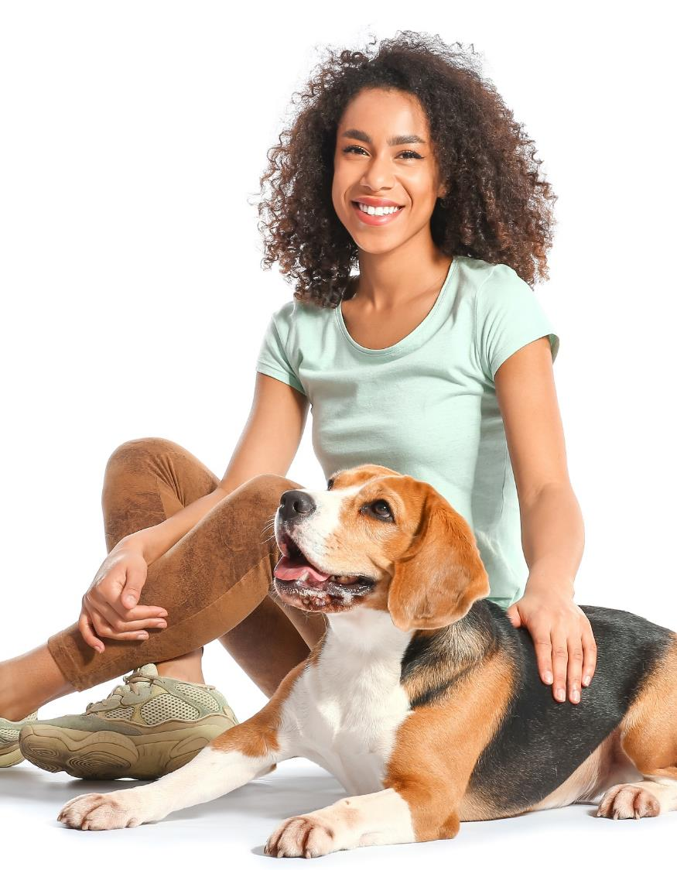
More ways to support pet parents
Financial assistance for pet adoption
Time off for those who welcome a new pet
Pet insurance
Financial assistance for responsible pet ownership choices like microchipping, neutering, behavior training
Pet bereavement leave
Financial assistance for pet daycare or dog walking if you can’t welcome pets onsite

Slide 15
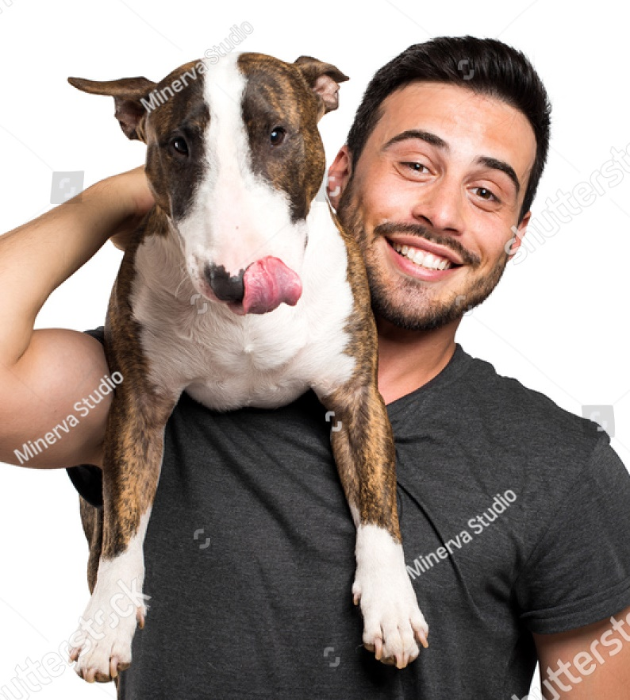
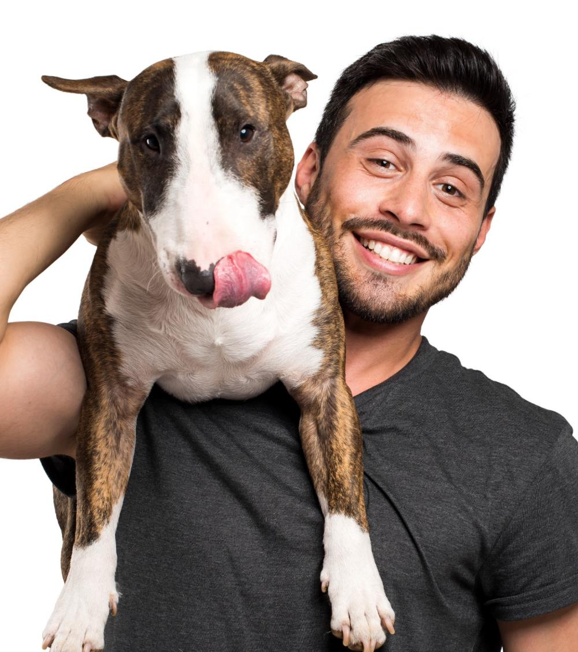
Make it easy with free resources
Get tips for pet-friendly offices, a sample pet policy, participant pledge and more at BetterCitiesForPets.com/PetsWorkAtWork
Visit CESARHireMyDog.com for a fun way to engage employees. The CESAR® brand is on a mission to make the world a dog-friendly place so people and pets can be together.

